Slide 1
Partial schedule generation

Slide 2
Partial Schedule Generation
Goals:
Greatly simplify constraints
Compromise between full schedule generation and no schedule generation
No schedule generation: really complex constraints
Full employee schedule generation: Infeasibly exponential number of schedules.

Slide 3
Difficult “ugly” constraints
Mon | Tue | Wed | Thu | Fri | Sat | Sun | Mon | Tue | Wed | Thu | Fri | Sat | Sun
 |  |  |  |  | OR | OR
 | / | s | s | s | s | s | /
Weekends are counted Saturday or Sunday
Consecutive (off) shift counts. Constraints between far away days.
Not very elegant to represent as ILP
→ Divide into blocks to simplify these.

Slide 4
Schedule is divided into blocks
Mon | Tue | Wed | Thu | Fri | Sat | Sun | Mon | Tue | Wed | Thu | Fri | Sat | Sun
Employee 1 has minimum block size 5.
Each block has a set of allowed sub schedules within that block.

Slide 5
Schedule is divided into blocks
Mon | Tue | Wed | Thu | Fri | Sat | Sun | Mon | Tue | Wed | Thu | Fri | Sat | Sun
Employee 2 has minimum block size 6. => weekends must be included whole in a block

Slide 6
Schedule is divided into blocks
Mon | Tue | Wed | Thu | Fri | Sat | Sun | Mon | Tue | Wed | Thu | Fri | Sat | Sun
Employee 3 has minimum block size 3.

Slide 7
Schedule is divided into blocks
Mon | Tue | Wed | Thu | Fri | Sat | Sun | Mon | Tue | Wed | Thu | Fri | Sat | Sun
 |  |  |  |  |  | F
Employee 4 has minimum block size 5. Free days allow for smaller blocks.

Slide 8
Resulting constraints
Generate all schedules for each block
Keep weekends whole
Adjacent Block Constraints
Co-occurence allowed Matrix from difficult constraints
Consecutive shifts
Shift may follow
Global Constraints
Translated from original constraints
Number of weekends
Total shifts
Max minutes
1 | 1 | 1 | 0
0 | 1 | 1 | 0
0 | 0 | 0 | 1

Slide 9
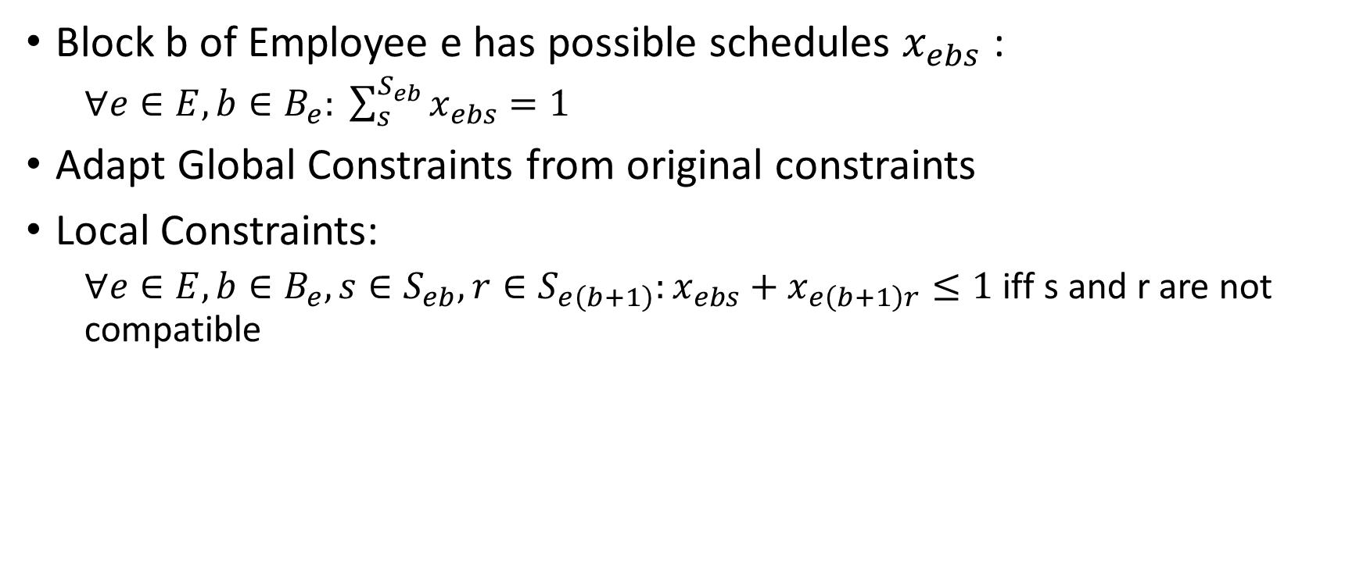
ILP Representation
Block b of Employee e has possible schedules $x_{ebs}$ :
$∀e∈E, b∈B_{e}: \sum_{s}^{S_{eb}}{x_{ebs}}=1$
Adapt Global Constraints from original constraints
Local Constraints:
$∀e∈E, b∈B_{e},s∈S_{eb}, r∈S_{e\left(b+1\right)}:x_{ebs}+x_{e\left(b+1\right)r}≤1$ iff s and r are not compatible

Slide 10
Maximal BiClique Optimization
Fewer tighter constraints
1 | 1 | 1 | 0
0 | 1 | 1 | 0
0 | 0 | 0 | 1

Slide 11
Performance measurements
Baseline Gurobi
Blocks Method
Time | LB | Best
0,107 | 607 | 607
1,29 | 828 | 828
0,98 | 1001 | 1001
10,67 | 1716 | 1716
70,07 | 1143 | 1143
20,67 | 1950 | 1950
29,23 | 1056 | 1056
3586 | 1300 | 1300
3601 | 406 | 439
18,0 | 4631 | 4631
16,0 | 3443 | 3443
Time | LB | Best
0,08 | 607 | 607
0,26 | 828 | 828
0,46 | 1001 | 1001
1,12 | 1716 | 1716
3,16 | 1143 | 1143
4,25 | 1950 | 1950
15,45 | 1056 | 1056
640 | 1300 | 1300
3600 | 439 | 439
58,16 | 4631 | 4631
233,7 | 3443 | 3443
1
2
3
4
5
6
7
8
9
10
11

